Slide 1
A Big Data Platform for Real-Time
Video Surveillance
Thi-Thu-Trang Do¹, Quang-Thinh Dam¹, Tai-Huy Ha¹,
Quyet-Thang Huynh², Kyungbaek Kim³, Van-Quyet Nguyen¹,
1 – Hung Yen University of Technology and Education, Hungyen, Vietnam
2 – Hanoi University of Science and Technology, Hanoi, Vietnam
3 – Chonnam National University, Gwangju, South Korea
Presenter: Quang-Thinh Dam

Slide 2
Content
Introduction
Design of the platform for real-time video surveillance
Experiments and Results
Conclusion and Future Work

Slide 3
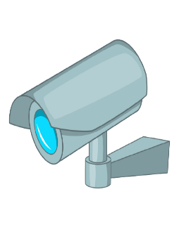



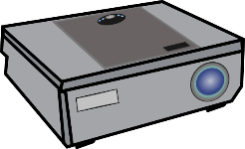
Problem
Introduction

Slide 4



Real Question
Introduction
Can we develop a system that supports to find out
the video segment containing the object with given description?
System
Upper: black, white
Lower: blue
Time: 6 PM - 7PM
Objects: projector
Time: 6:15 PM
Input
Output

Slide 5
Key Challenges
Introduction
Machine learning and deep learning model
Train a model which has ability to extract properties from objects
Large-scale computation
Large amount of data generated by cameras
Unstructured - hard to control
Real-time processing

Slide 6
Related Work
Introduction
Bunrong Leang et al [Sensors’ 2019]: : Improvement of Kafka streaming using partition and multi-threading in big data environment
Build a Hadoop ecosystem to support several features in the manufacturing industry
Distributed processing
Ayae Ichinose et al [IEEE, 2017] : A study of a video analysis framework using Kafka and spark streaming
Propose a Streaming Video Engine for uploading and processing videos in a distributed manner.
Real-time video analysis on Spark
Raise analyzing and processing data speed

Slide 7
Related Work
Introduction
Fu et al [IEEE, 2016] : Spark--a big data processing platform for machine learning
Introduce BigDL - distributed deep learning framework using Spark
Support object detection and image feature extraction
Support immensely efficient and scalable distributed training
Lei Huang et al [IEEE, 2017] : Enabling versatile analysis of large scale traffic video data with deep learning and HiveQL
Introduce a method based on convolutional neural networks for recognizing objects in traffic video data.
Support processing and storing video data
Melenli et al [ICAIAME, 2020] : Real-time maintaining of social distance in covid-19 environment using image processing and big data
Introduce a distributed image processing framework in real-time using Apache Kafka and Spark
Support performing human detection and measured the distance between people
Implement a web interface for user

Slide 8
Problem Statement
Introduction
How to collect and store massive data from multiple cameras?
How to build a deep learning model that can detect objects displayed in cameras and extract properties from objects?
Can we modeled streaming data generated from multiple cameras to support video querying with given conditions?

Slide 9
Content
Introduction
Design of the platform for real-time video surveillance
Experiments and Results
Conclusion and Future Work

Slide 10
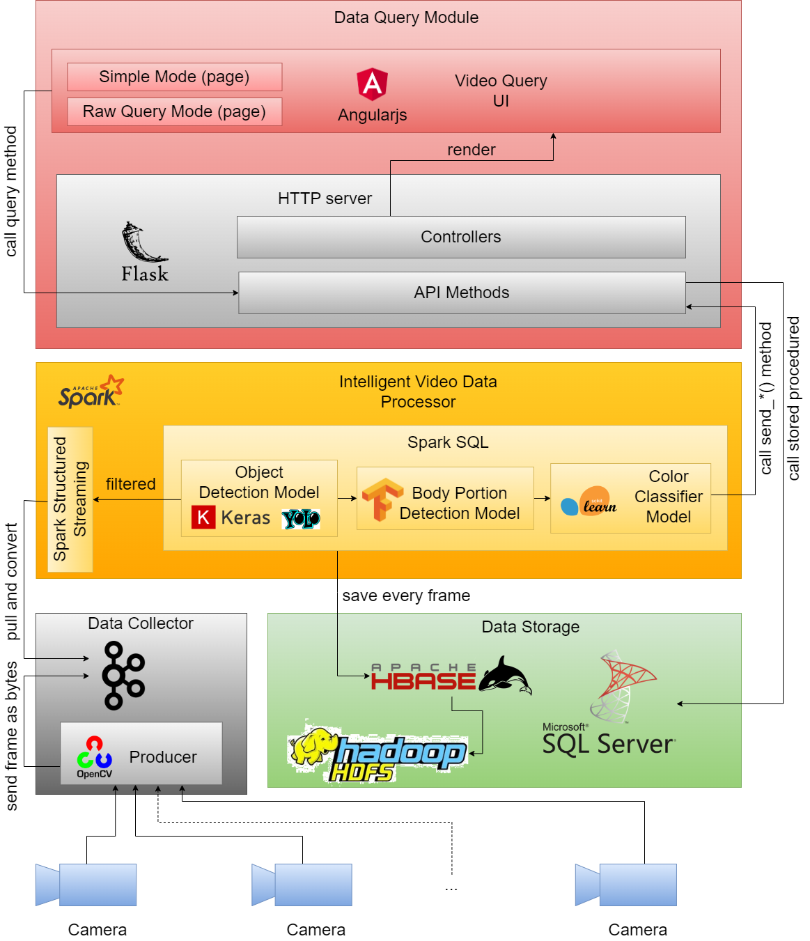
System Architecture
Design of the platform
Including 4 components:
Data Collector
Intelligent Video Data Processor
Data Storage
Data Query Module
Notes:
Why Distributed System?
Handling massive data
Real-Time data processing
Real-time situation awareness
Camera-based people counting
1 image ➔ 100ms [39]
100 images ➔ 10s
1000 images ➔ 100s

Slide 11
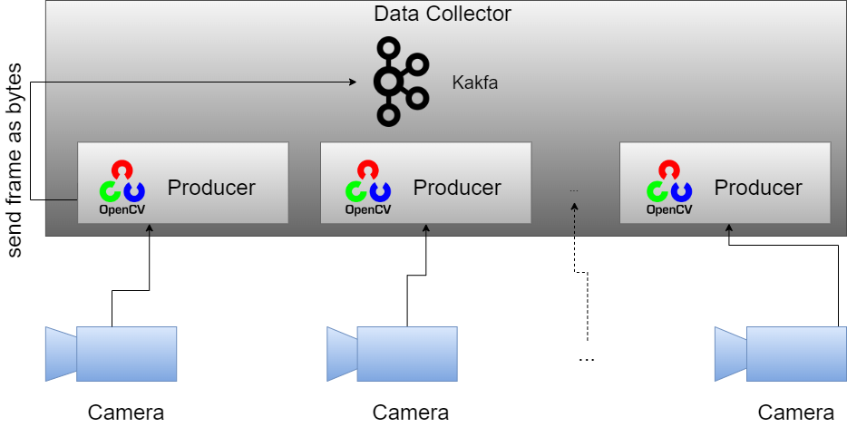
Design of Data Collector
Design of the platform
Collect data from cameras
Each camera has a producer to collect data
A video recorded by a camera will be separated into frame
Transforms them into bytes then send to Kafka cluster

Slide 12
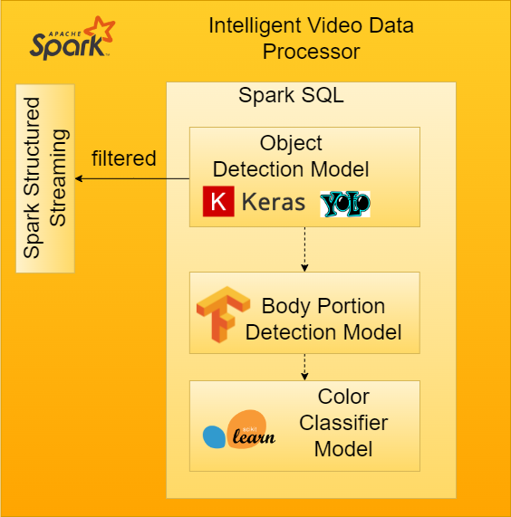
Design of Intelligent Video Data Processor
Design of the platform
Broadcast model weight to workers
Filters frames consumed by using Spark SQL
Use YOLO model to detect object displayed in frame
If YOLO detected human, detach human’s frames, then use body portion detection model to detect body parts.
Then use a simple ML model (KNN) to classify the color of body parts

Slide 13
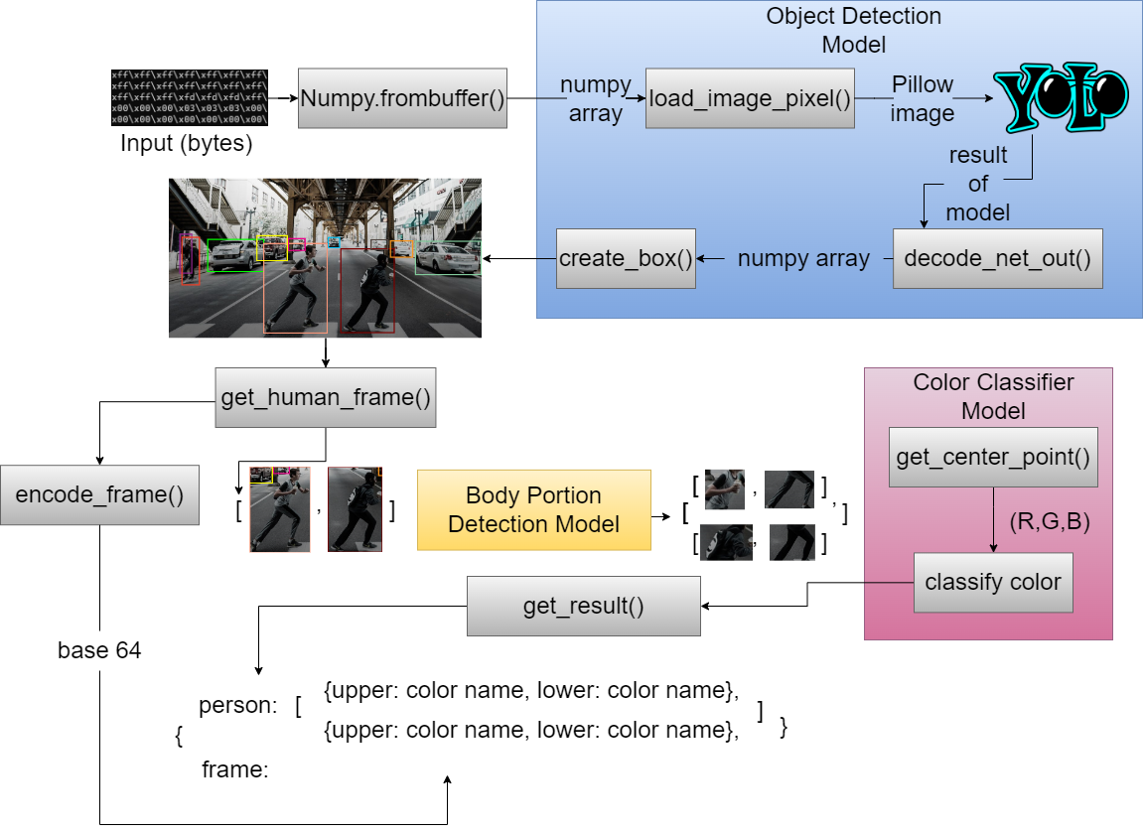
Processing image using machine learning ẩn
Design of the platform

Slide 14

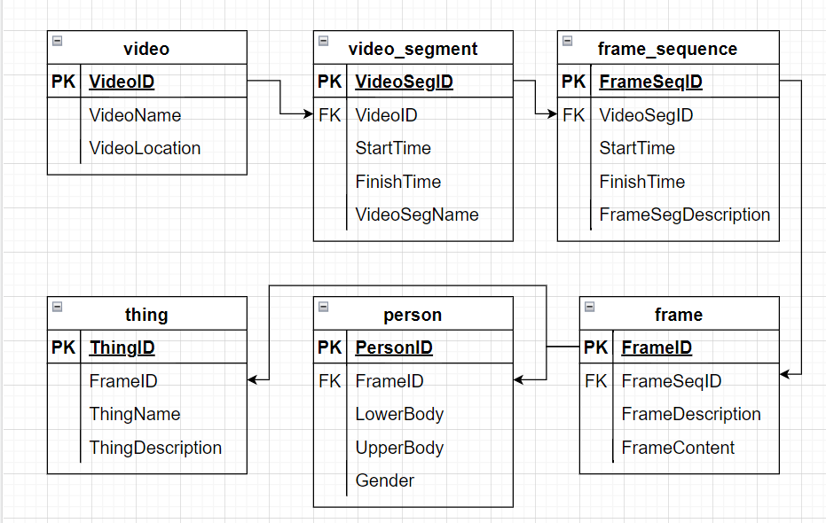
Design of Data Storage
Design of the platform
Hbase & HDFS
Fast when writing data, suitable with streaming
Distributed – No data losing
SQL server
Save and organize data relationally.
Easy to query by using SQL
Just save some data that contains objects

Slide 15
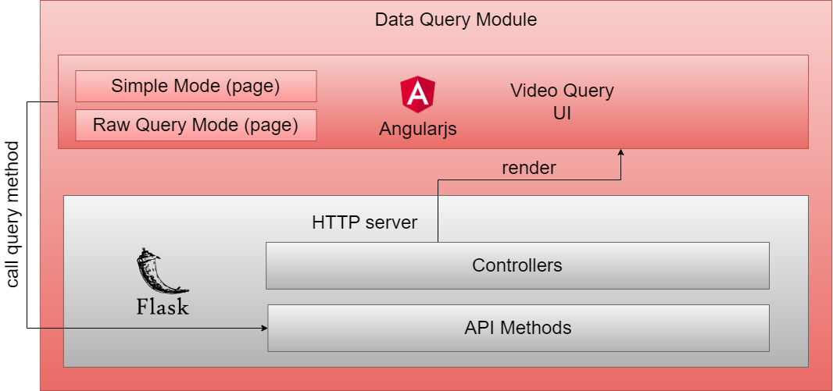
Design of Data Query Module
Design of the platform
Simple, light weight
Easy to integrate with the system
Fast to develop

Slide 16
Content
Introduction
Design of the platform for real-time video surveillance
Experiments and Results
Conclusion and Future Work

Slide 17
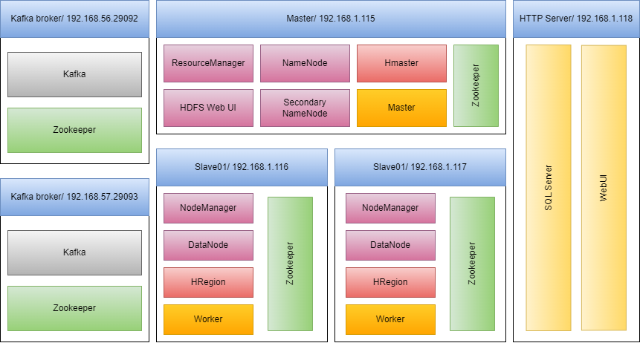
Environment Settings
Experiments and Results

Slide 18
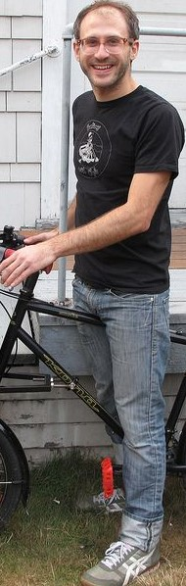
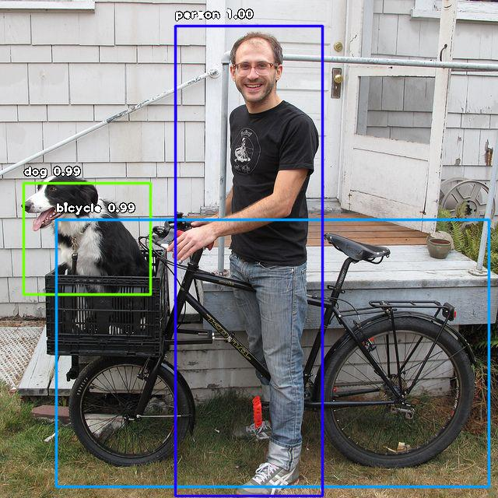
Dataset and Model Trainning
Experiments and Results
Body portion detection model
YOLOv3
Upper
Upper
Collect image
Label image
Train size: 10,000
Test size: 5,000
Validate size: 5,000
Evaluate AP(average precision)
Upper: 0.48437712
Lower: 0.48437712

Slide 19
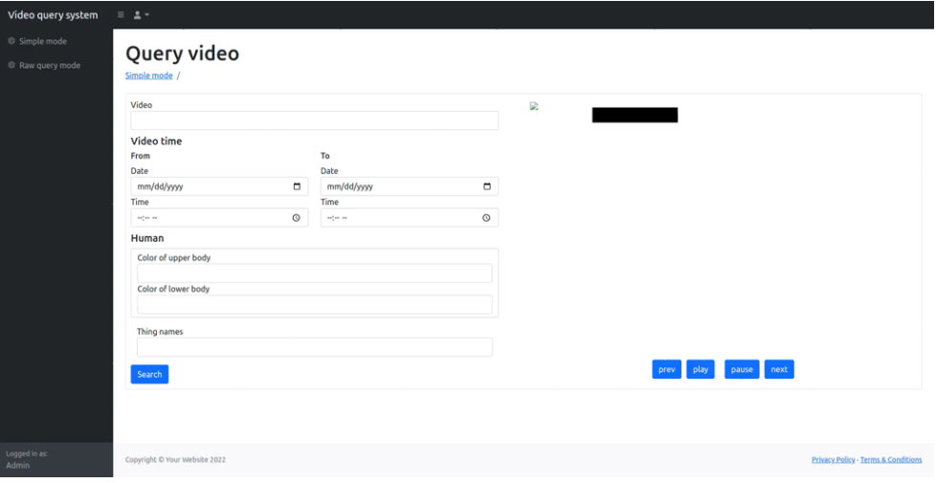
Experimental Results them kết quả đánh giá
Experiments and Results
Experiment 1: Finding a man with description and specified location (yard)

Slide 20
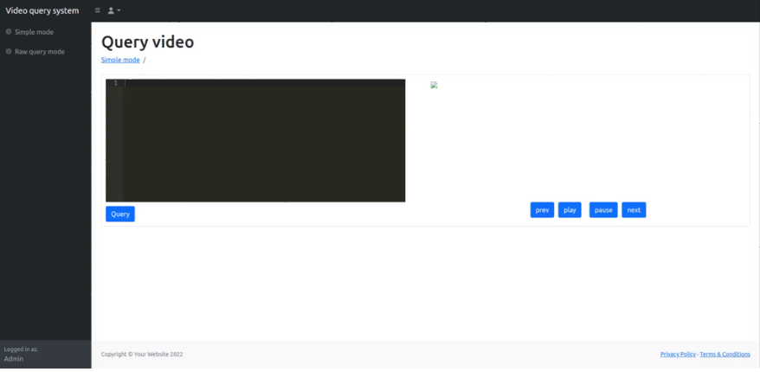
Experimental Results
Experiments and Results
Experiment 2: Using raw query mode

Slide 21
Content
Introduction
Design of the platform for real-time video surveillance
Experiments and Results
Conclusion and Future Work

Slide 22
Conclusion and Future Work
Conclusion
We designed the distributed video surveillance platform
We implemented a physical smart indicator
We trained the model that can extract object properties
Future work
Integrate with distributed search engine
Improve accuracy of machine learning model

Slide 23
Thanks for your attention!
Q&A

